Slide 1
PBM Payment Hold Release — Comprehensive Overview (/cvs + /v1, REST-only)
Combines eligibility, consent, resolve, and refresh with UX/server details for t-shirt estimates

Slide 2
Executive Summary
Members release PBM mail-order Payment Holds from the Aetna portal
Transport
REST only
Ownership & Routing
Portal → Aetna /v1 (new proxy/BFF) → CVS /cvs (existing Experience API)
Happy Path: Eligibility → Consent → Resolve → Refresh
Outcomes: faster fulfillment, reduced calls, auditable member action

Slide 3
Scope & Non-Scope
In Scope
PBM mail-order Payment Hold (reason=54)
Portal UX: CTA, consent/payment, success/error
Aetna /v1 proxy to CVS /cvs
Cache purge + audit (portal-owned)
Out of Scope
EBDS Bill Holds
SLP Payment Holds
Creating new CVS endpoints
Payment tokenization changes (reuse existing)

Slide 4
Endpoint Map (Who owns what)
Aetna /v1 (new)
GET /v1/high-cost-hold?rxId&memberId
POST /v1/payment-consent
POST /v1/orders/{orderId}/resolve-payment-hold
GET /v1/orders/{orderId}
Headers: Idempotency-Key (POST), X-Trace-Id
CVS /cvs (existing)
GET /cvs/high-cost-hold?rxId&memberId
POST /cvs/payment-consent
POST /cvs/orders/{orderId}/resolve-payment-hold
GET /cvs/orders/{orderId}
Auth: OAuth2 client credentials

Slide 5
End-to-End Flow (Happy Path)
1) GET /v1/high-cost-hold → shows CTA when ELIGIBLE + reason=54
2) POST /v1/payment-consent → returns consentReference
3) POST /v1/orders/{orderId}/resolve-payment-hold → returns released + auditId
4) GET /v1/orders/{orderId} → verify cleared; purge cache; write audit

Slide 6
Error Paths & Handling
Eligibility ineligible
Hide CTA; re-check on navigation/refresh
Consent rejected (4xx)
Show provider message; no retry; allow edit+resubmit
Resolve failed (5xx/429)
Exponential backoff; show retry; persist failure audit
Idempotency replay
Return original result; no duplicate side-effects

Slide 7
Examples — Aetna /v1 (proxy/BFF)
GET /v1/high-cost-hold?rxId=RX123&memberId=M-12345
POST /v1/payment-consent
{ "orderId":"ORD-10001",
"rx":[{"rxNumber":"1234567","consentResponse":"Y"}],
"paymentInstrument":{"token":"pm_..."},
"memberId":"M-12345", "traceId":"TRACE-..." }
→ { "status":"accepted","consentReference":"CONS-9f2c3" }
POST /v1/orders/ORD-10001/resolve-payment-hold
{ "rx":[{"rxNumber":"1234567"}],
"memberId":"M-12345","consentReference":"CONS-9f2c3",
"traceId":"TRACE-..." }
→ { "result":"released","auditId":"AUD-20251010-001" }

Slide 8
Forwarded — CVS /cvs (Experience API)
GET /cvs/high-cost-hold?rxId=RX123&memberId=M-12345
POST /cvs/payment-consent
POST /cvs/orders/ORD-10001/resolve-payment-hold
GET /cvs/orders/ORD-10001

Slide 9
UX Requirements
CTA visible only when ELIGIBLE + PAYMENT_HOLD + reason=54
Consent dialog
member-friendly copy
reuse tokenized payment UI
Success toast + auto-refresh of RX details
Error copy from provider messages; retry affordance; accessibility (SR/live region)

Slide 10
Engineering Requirements (/v1 + Portal)
OAuth2 client credentials for /cvs; secrets rotation
Idempotency-Key (POST), X-Trace-Id propagation (all)
Retries: backoff on 5xx/429; no retry on 4xx
Cache purge and append-only audit on success/failure
Dashboards: success/error rates, retries, time-to-release

Slide 11
Non-Functional Requirements
Availability: read path usable if actions down
Latency: p95 GET ≤ 300 ms; POST ≤ 600 ms
Security: tokenized payment only; minimum identifiers
Compliance: audit retention per policy
Rate limits: align with /cvs quotas

Slide 12
Assumptions & Dependencies
CVS /cvs exposes 4 routes
Proper scopes: experience.read & experience.write
Portal has existing payment tokenization + PCI segmentation
Seeded test data for reason=54

Slide 13
Risks & Mitigations
Contract drift with /cvs
Contract tests in CI; sandbox parity; alerts
Eligibility flaps mid-session
Re-check before POST; disable if state changed

Slide 14
T-Shirt Sizing Inputs
Work Items
UX: 2–3 screens (detail, consent/payment, success/error)
FE: 4 /v1 calls, idempotency, retry, cache purge
BE (/v1): thin proxy, OAuth2, logging, metrics
QA: happy, edge, and error paths; automation
Cross-Cutting
Security: secrets, scopes, headers
Ops: dashboards, alerts, runbook
Release: dark launch → phased GA

Slide 15
Timeline Strawman
W1: Confirm /cvs contracts; UX copy; /v1 scaffolding; OAuth2 creds
W2–W3: FE flows + /v1 proxy; error mapping; idempotency
W4: QA + sandbox E2E; dashboards; bug-bash
W5: Dark launch (5–10%); observe; GA roll

Slide 16
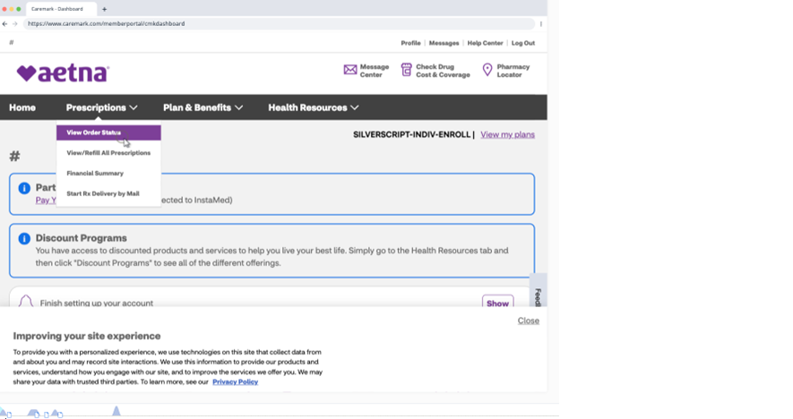
UI Flow
1/4 Orders list — context. Delayed card visible when ELIGIBLE; leads to details.

Slide 17
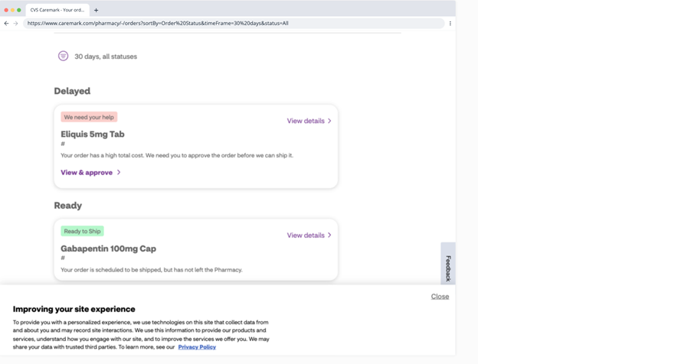
UI Flow
2/4 Order details — 'We need your help' = eligibility (reason=54) → Approve CTA.

Slide 18
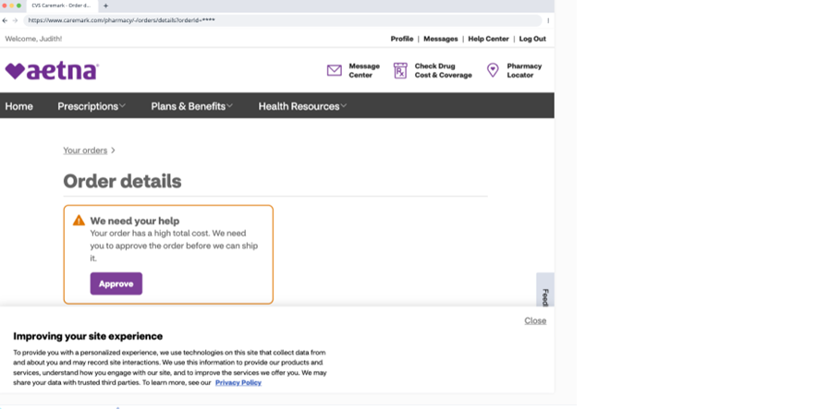
UI Flow
3/4 Delayed card — 'View & approve' → consent capture then POST /v1/payment-consent.

Slide 19
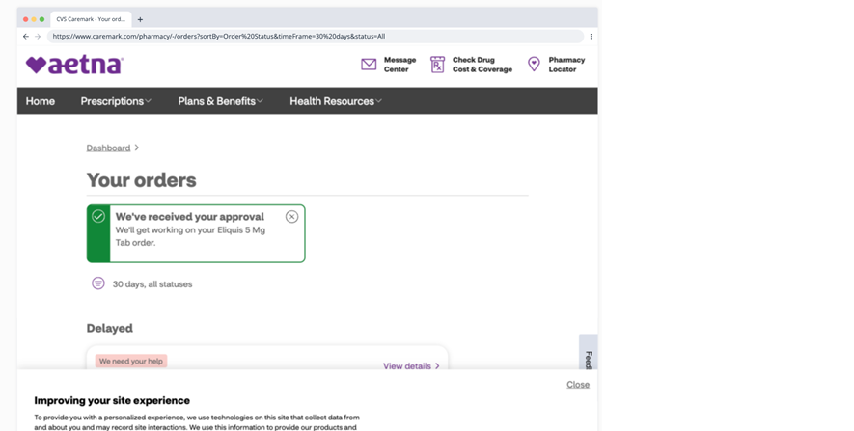
UI Flow
4/4 Dashboard nav — 'View Order Status' entry into the same flow.

Slide 20
Appendix — OpenAPI Paths (excerpt)
GET /v1/high-cost-hold?rxId&memberId → forwards to /cvs/high-cost-hold
POST /v1/payment-consent → forwards to /cvs/payment-consent
POST /v1/orders/{orderId}/resolve-payment-hold
→ forwards to /cvs/.../resolve-payment-hold
GET /v1/orders/{orderId} → forwards to /cvs/orders/{orderId}

